Slide 1
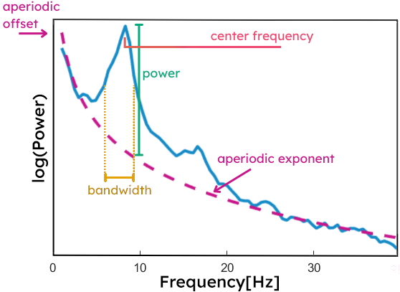
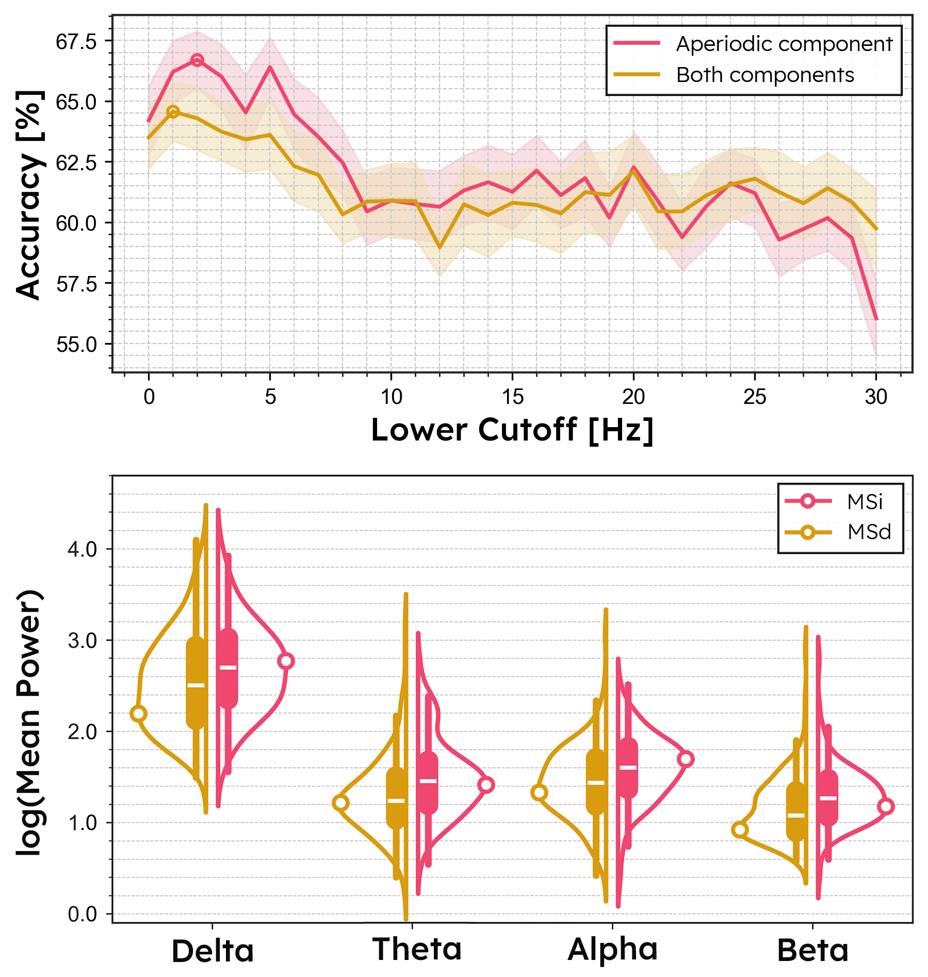
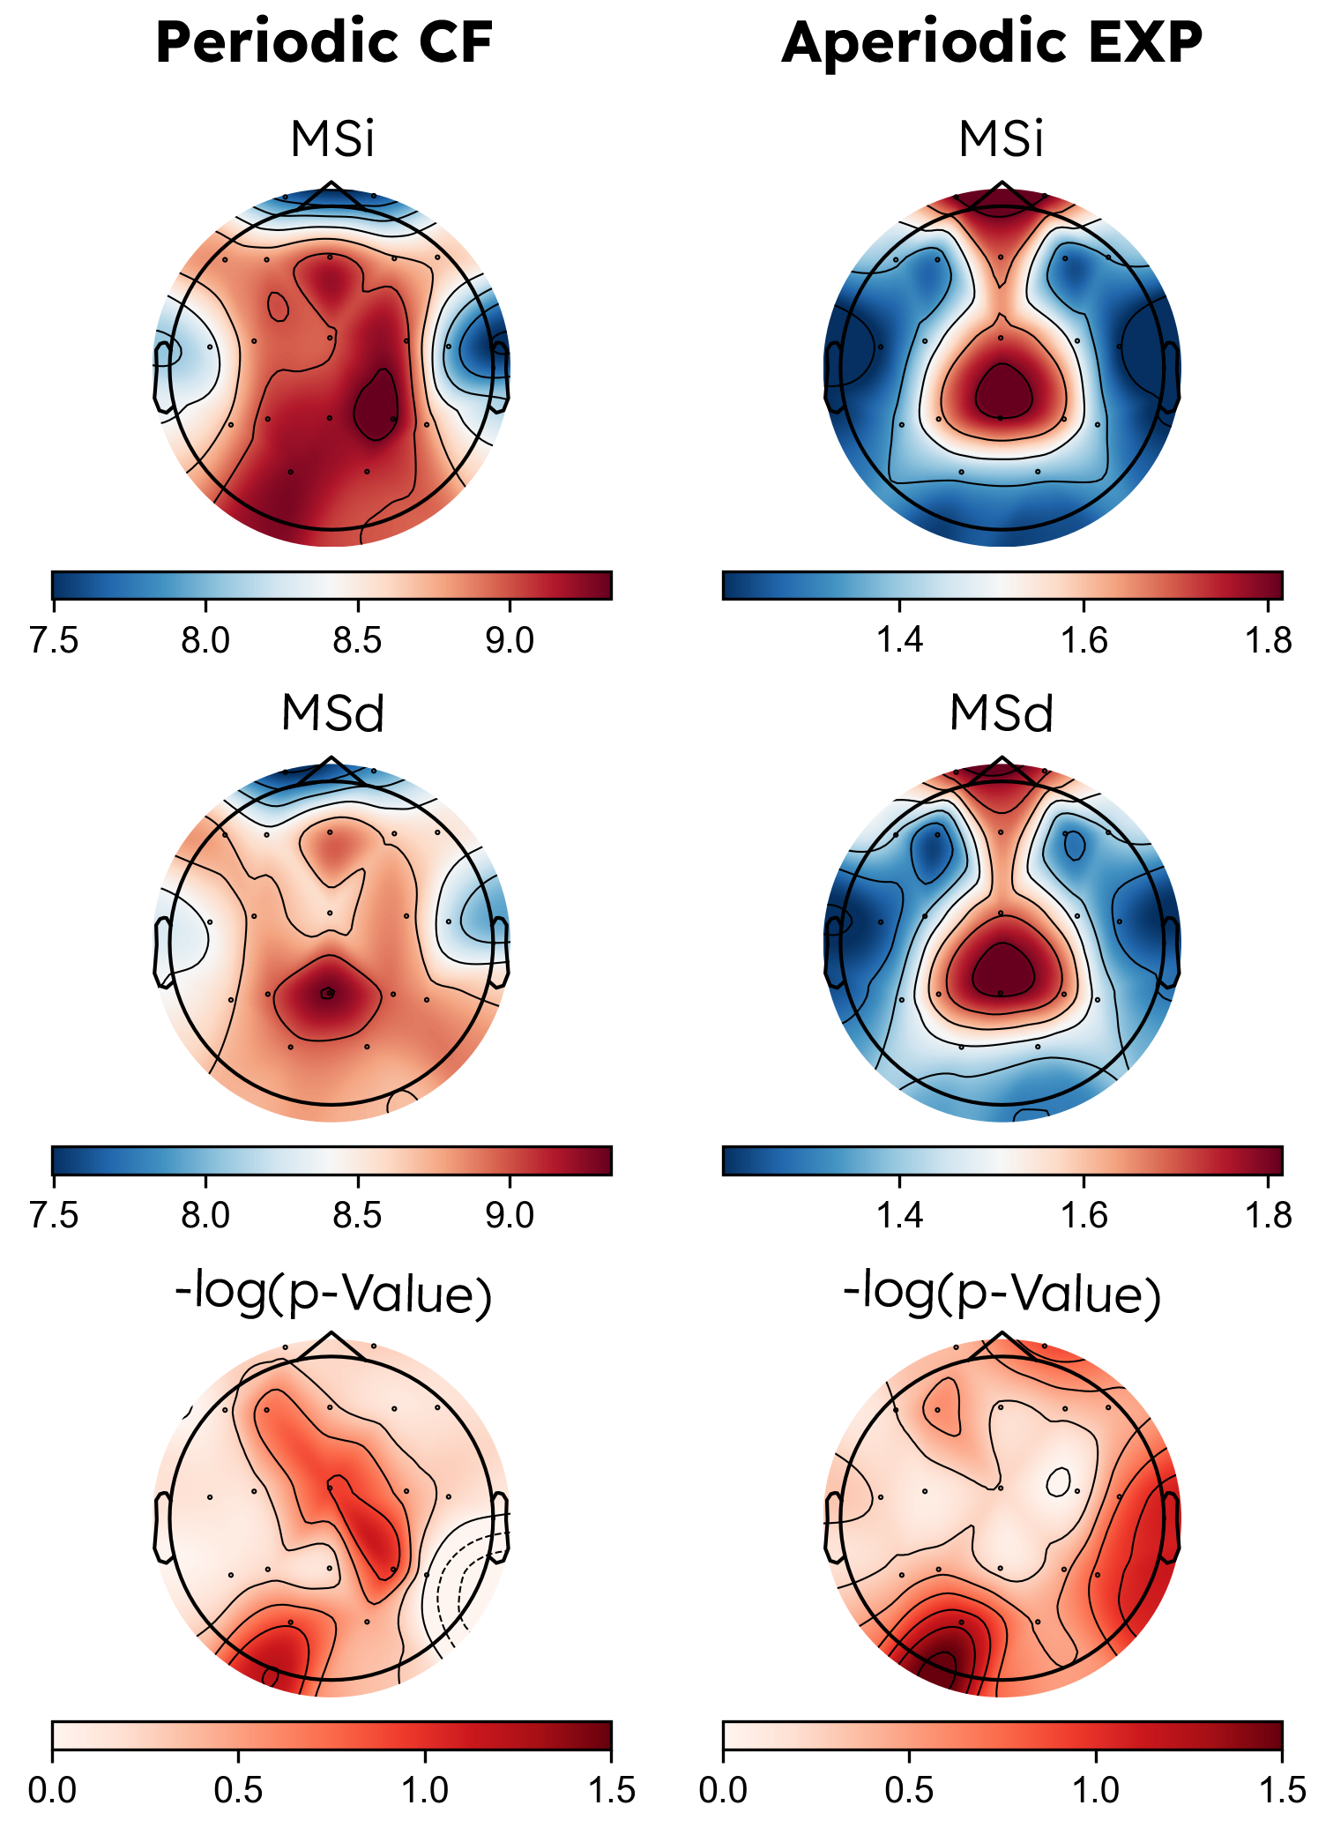
Utility of periodic and aperiodic EEG components in detecting cognitive impairment in PwMS
Kien N.D., Akbarian F., Manh D.Q., Laton J., Engelborghs S., Van Schependom J., Trung N.L., Nagels G.
Introduction: Cognitive deterioration is an important symptom of MS. The golden standard for evaluating cognition is the neuropsychological examination. With regard to biomarkers, periodic EEG components have previously been shown to carry information about cognitive state. Recently, the aperiodic EEG component has gained interest.
Aim: To evaluate the value of periodic and aperiodic components in detecting cognitive impairment in PwMS.
Methods:
We assessed cognition in 307 PwMS using the brief repeatable neuropsychological test battery (BRB-N).
EEGs recorded during a cognitive oddball task were transformed to power spectra. Periodic and aperiodic components were extracted using the fitting oscillations & one over f (FOOOF-tool) and analyzed with a logistic regression classifier.
Periodic and aperiodic EEG components are potential biomarkers for cognitive state in PwMS.
Results:
Higher aperiodic exponents were associated with impaired cognition.
Optimal classification reached 66.7% in the [2-40] Hz range.
Aperiodic information performed better across a wider frequency band.
EEG topography revealed cognitive deterioration linked to a steeper 1/f slope in multiple scalp regions.
duc.kien.nguyen@vub.be

